Slide 1
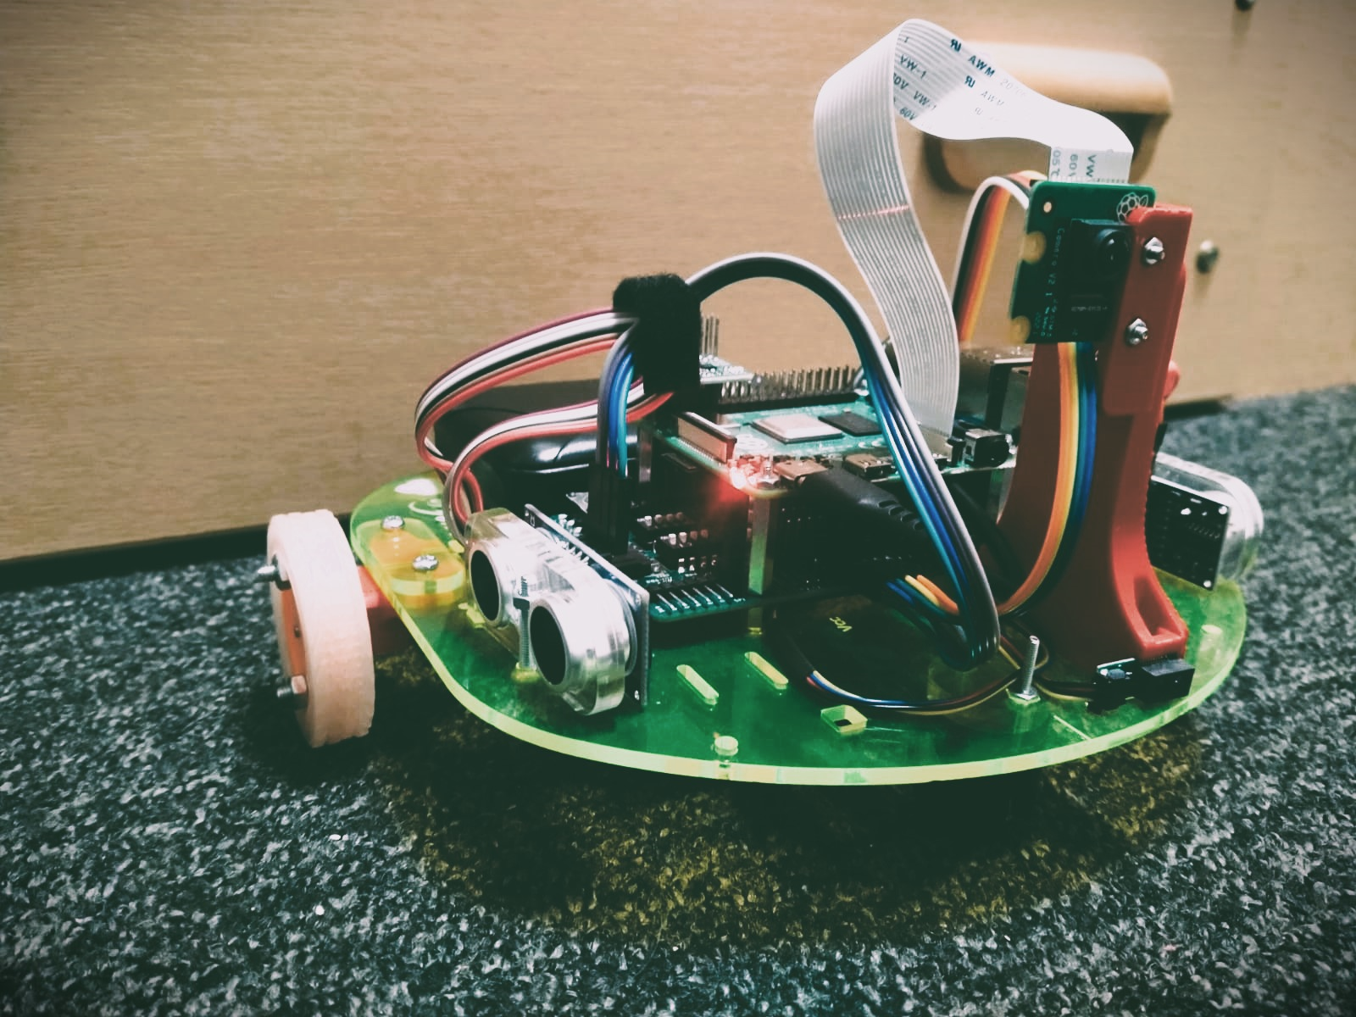

NAVIGATING MOBILE ROBOT
SUBTITLE: ”PRACTICAL ROBOTICS” –[ELE00152M]
YOUR NAME: SUMAN MAHADEVA
STUDENT ID: 209077452

Slide 2
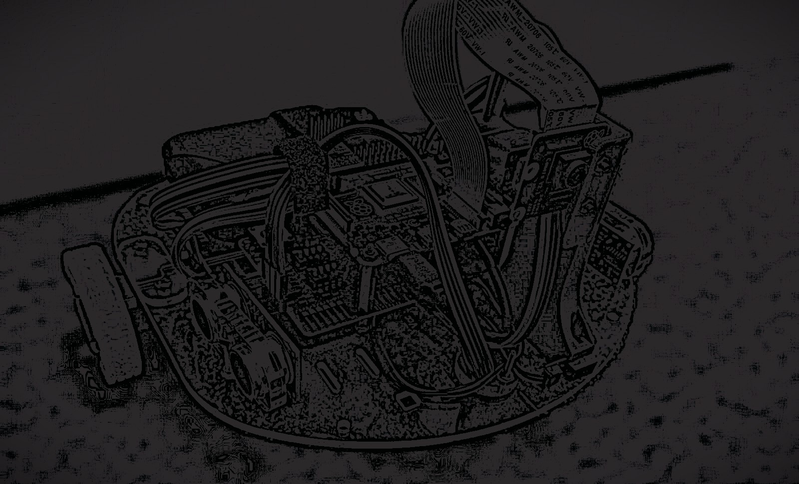
Table of content
1. INTRODUCTION
2. OVERVIEW OF ROBOTICS
3. APPROACH OF THE ARDUINO
4. CAMERA INITIALIZATION AND CONFIGURATION
5. CONFIGURING AND OUTLINING ROBOTIC GRID MODELS

Slide 3
INTRODUCTION
Greetings to all of you for this presentation on the ELE00152M Practical Robotics module in the academic year 2023–2024, the Navigating Mobile Robot Assessment project is examined in this presentation. A mobile robot that can navigate around indoor areas is what the project aims to build. The project's objectives are to show off the best path design, properly map its surroundings, and avoid impediments. From building the robot chassis to putting sophisticated navigation algorithms into place, the presentation will go over each stage of the project. Technical expertise, original problem-solving, and strong communication are essential to the project's success. An understanding of the robot's design, operation, and navigational problem-solving techniques will be provided during the presentation.

Slide 4
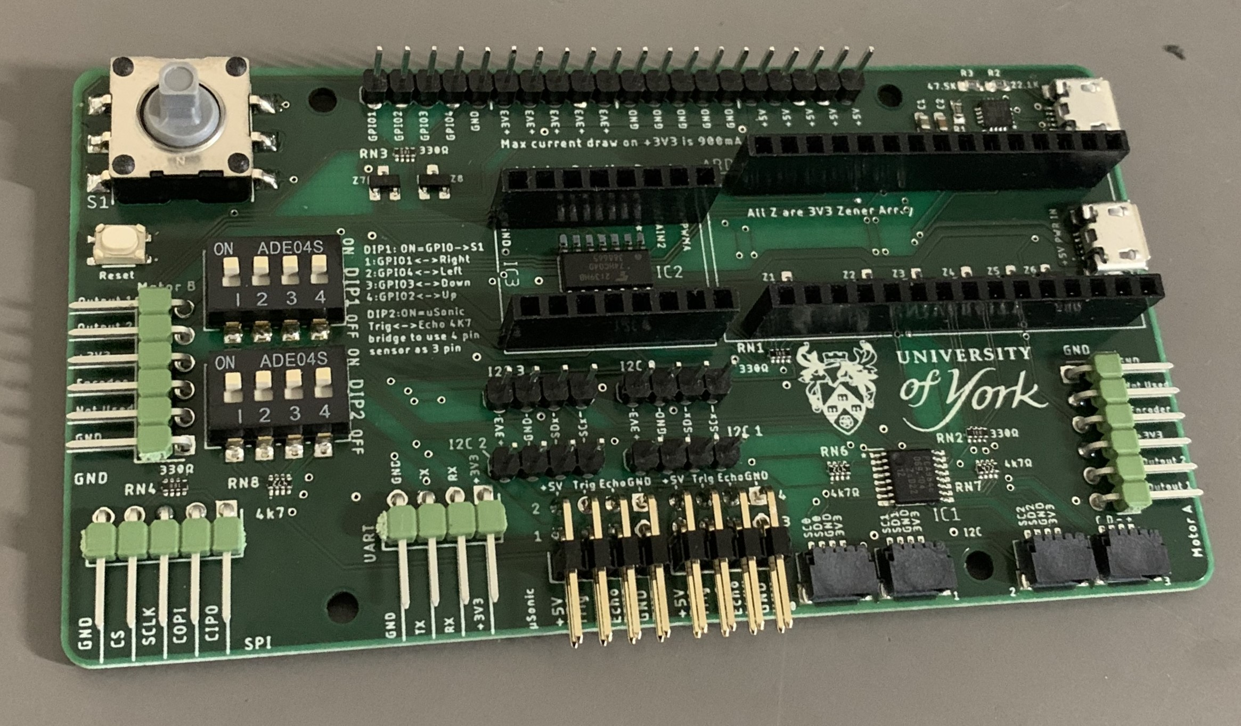
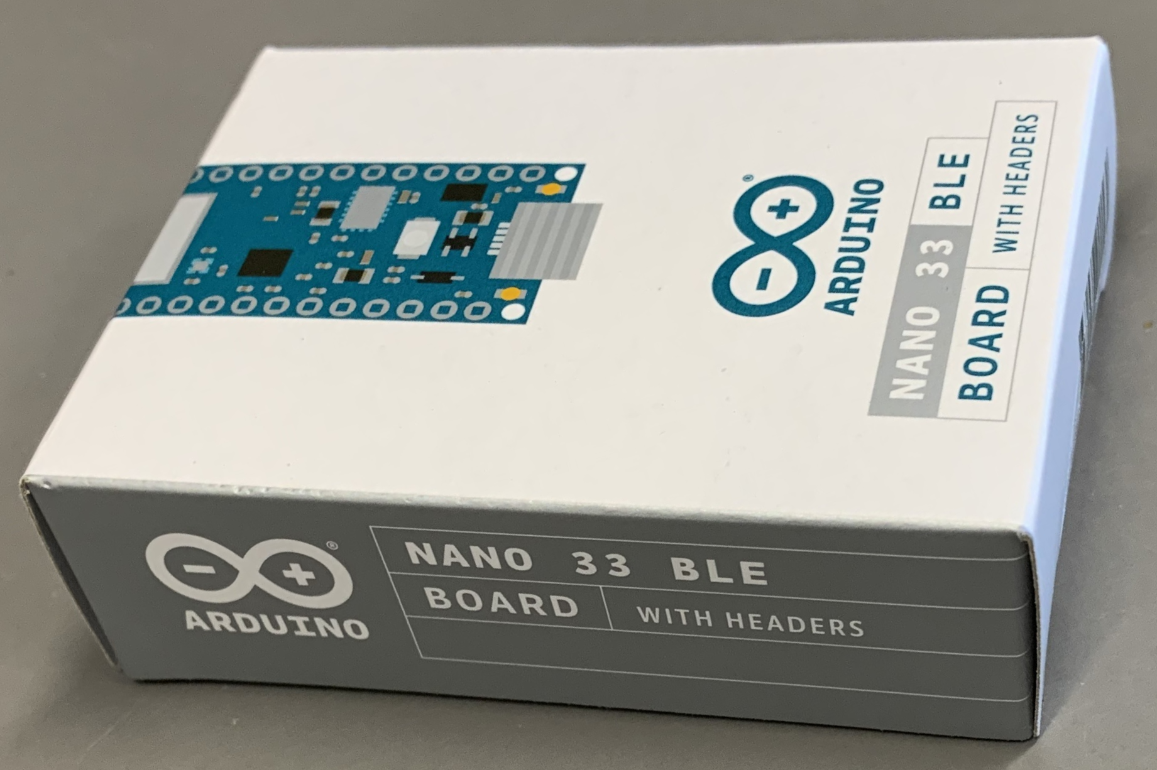
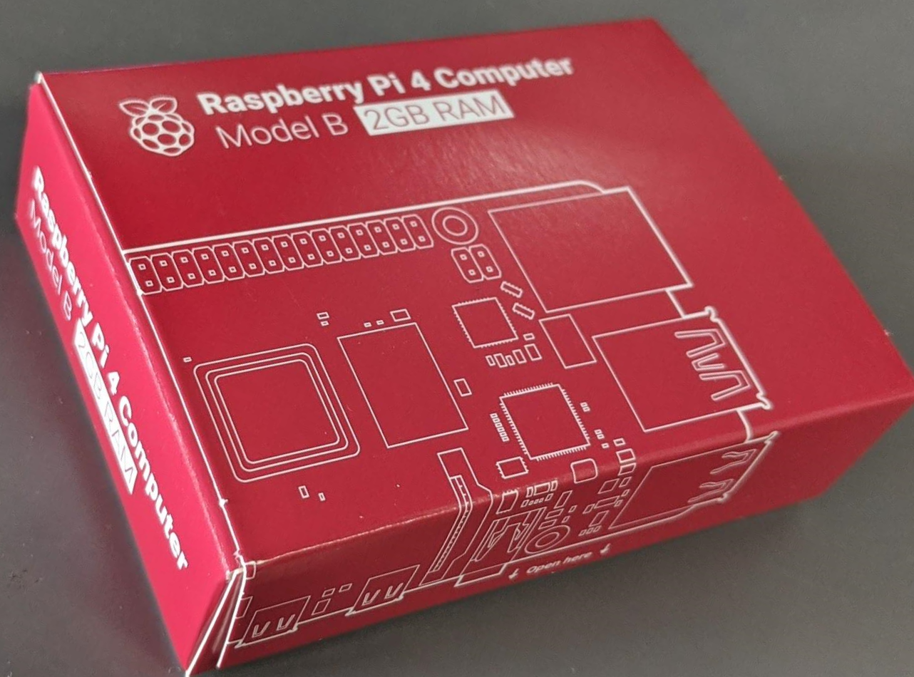
OVERVIEW OF ROBOTICS
• Chassis with Camera and Motor Mounts: Offers a structure for attaching additional parts.
• Raspberry Pi 4: The primary computer used for data processing, algorithm execution, and motion control.
• Arduino Robotics Board (ARB): A robotics application-focused Arduino-based board.
• Pololu TB6612FNG Dual Motor Driver: Manages motor motion, facilitating the operation of differential drives.
• Infrared and Ultrasonic Range Sensors: Crucial for identifying and avoiding obstacles.
• Micro-Metal Gear Motors with Encoders: Drive wheels that offer accurate feedback and control.
• Wheels: Essential to the mobility of the robot, they fit on micro-metal gear motors.
• Other Parts: Contains assembly parts, connections, and structural elements.
• Camera: Connected to the Raspberry Pi to perform vision-based functions including obstacle identification and maze navigation.

Slide 5
APPROACH OF THE ARDUINO
IR Sensor Readings:
• Uses readIRSensorDistance function to read distance values from an IR sensor.
• Communicates with the sensor using I2C to get the distance in centimetres.
Ultrasonic Sensor Readings:
• Uses two ultrasonic sensors (ultra for left and ulra1 for right).
• Trigger pulses are sent to the sensors, and distances are calculated in centimetres.
Motor Control:
• Functions moveForward, turnLeft, turnLeft1, turnRight1,turn180 and turnRight control the robot's movement.
• Motors are controlled by setting their direction and adjusting the PWM signal for speed.
Serial Communication:
• Sensor values are printed to the serial monitor for debugging and monitoring.
• Distances from IR and ultrasonic sensors, along with control signals from a Raspberry Pi, are sent back to the Raspberry Pi.
Control Logic:
• Loop function decides the robot's actions based on the received control signal.
Cleanup:
• SerialUpdate function updates the serial communication.
Enums and Constants:
• Enums and constants are used for better readability and maintainability of the code.
Design Approach:
• The robot’s behaviour is determined by a combination of IR and ultrasonic sensor readings and external control signals.

Slide 6
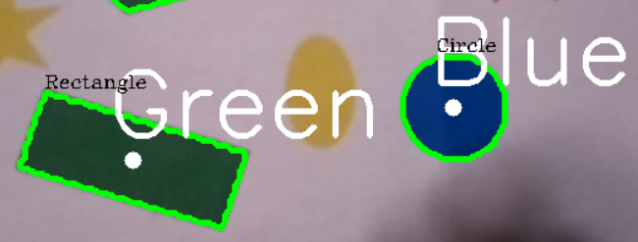
CAMERA INITIALIZATION AND CONFIGURATION
Object Detection using Color Masks
• Uses PiRGBArray object for raw RGB image data.
• Defines four colour masks using HSV colour ranges.
• Isolates regions of specific colours in the captured frame.
Contour Detection and Analysis
• Finds contours in each colour mask using OpenCV's findContours function.
• Calculates contour areas, centroids, and moments of the contours.
Shape Recognition
• Uses several vertices in the contour to identify different shapes.
• Adds text to the image to label each detected shape.
Display and User Interaction
• Displays processed frame with drawn contours and labelled shapes using OpenCV.
• Continuously updates frame in a loop.
Algorithm Used
• Contour detection, shape recognition, and basic geometric calculations are the main algorithms.
Design Approach
• Involves real-time video processing, colour-based segmentation, contour analysis, and shape recognition.

Slide 7
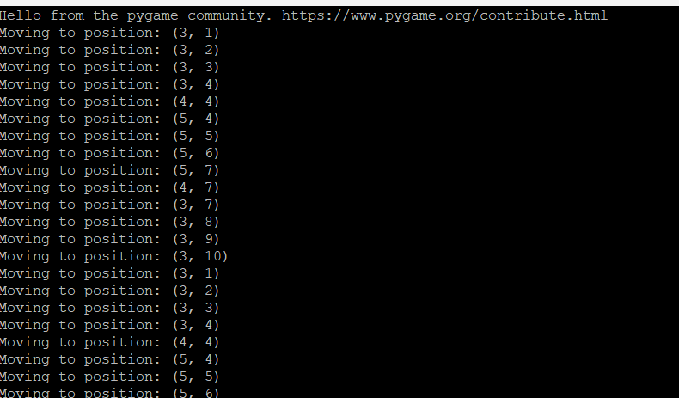
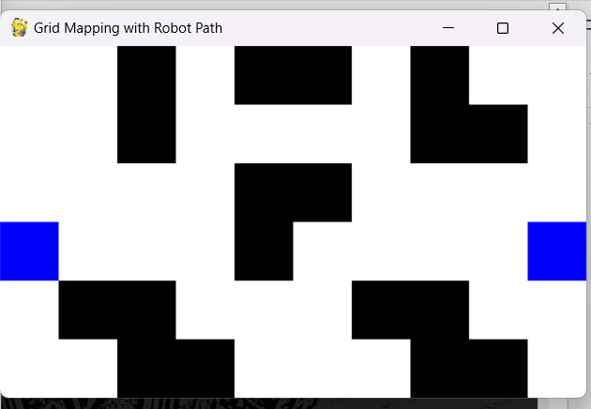
CONFIGURING AND OUTLINING ROBOTIC GRID MODELS
Box size and grid dimensions are specified in the grid setup.
• Identifies impediments such as blocked boxes.
• Identifies where the robot's journey starts and finishes.
Pygame is started by:
• Setting up Pygame and creating a window according to the size of the grid.
Defining the draw_grid function allows the grid to be shown in the Pygame window for grid drawing.
• Based on the condition of the grid, draws rectangles.
Robot Motion:
• Specifies the move_robot function for simulating robot motion.
• This assumes that the robot is at coordinates (3, 1).
The Flood Fill Algorithm searches the grid for a route that leads from the Start to Finish and Finish to Start

Slide 8



